Slide 1
Moral Self-Identity
Daniel Lapsley
Notre Dame Conference on Virtue Development
May 22, 2014
www.nd.edu/~dlapsle1/Lab

Slide 2
Overview
Situate moral self-identity
Ethical theory
Developmental psychology
Social cognitive accounts of “moral personality”
Chronic accessibility of moral schemas (Lapsley & Narvaez)
Centrality of morality within working self concept (Karl Aquino)
Developmental pathways

Slide 3
“In my beginning is my end”
--T.S. Eliot (“East Coker”)
Major Points
Moral identity reflects the importance of what we care about
A moral person engages in strong evaluation
But depends on accessibility of moral identity
(understood in social cognitive terms)
Moral identity can be chronically accessible or have high centrality within working self-concept
Or activated or deactivated by situations
There is a developmental story

Slide 4
Situating Moral Self-Identity
Greater interest in drawing tighter connection between moral agency and personality
Charles Taylor
“Being a self is inescapable from existing in a space of moral issues”
Augusto Blasi
Elevates moral self-identity for understanding moral behavior

Slide 5
A person is more likely to follow through on what moral duty requires if the self is constructed on moral foundations
i.e., to the extent that one identifies with morality and cares about it.
Harry Frankfurt: “The Importance of What We Care About”

Slide 6
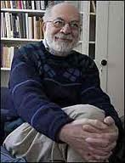
“The Importance of What We Care About”
Persons v. Wantons
Persons care about morality
Persons reflect upon desires, forms judgments
“Second-order desires”
A person orders desires and evaluates them
And wishes to conform behavior accordingly
Wantons are beset by first-order desires
A wanton doe not care about desirability of his/her desires

Slide 7
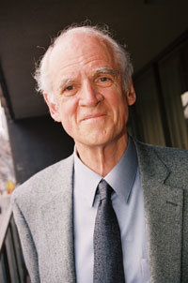
An individual is a person to the extent s/he engages in strong evaluation
Make ethical assessments about first-order desires
Make discriminations about what is higher or lower; worthy or unworthy, better or worse
C. Taylor
Distinctions made against a horizon of significance
Our identity is defined by strong evaluation
“To know who I am is a species of knowing where I stand”
C. Taylor (1989)

Slide 8
Moral identity is marked by second order volitions and strong evaluation
It is defined by reference to things that have significance to us
“My identity is defined by the commitments and identifications which provide the frame or horizon within which I can try to determine from case to case what is good or valuable, or what ought to be done or what I endorse or oppose”
--C. Taylor (1989)

Slide 9
The Psychology of Moral Identity
The moral self identifies with morality and builds the self around moral commitments
Moral commitments cut to the core of who we claim ourselves to be
Morality is essential, central and important to self
But not everyone builds the self on morality
define the self around other priorities
Or emphasize different aspects of morality: justice, care, beneficence

Slide 10
Moral identity as a dimension of individual differences, i.e., “personality”
One has a moral identity when moral notions are central, essential, important to self-understanding
Failure to act in a way self-consistent with moral commitments is to risk self-betrayal
And herein the motivation for moral behavior

Slide 11
Motivation of individuals who rescued Jews during Holocaust
Moral “exemplars”
Care exemplars
Moral exemplars show better identity development

Slide 12
Personality Science
“Two Disciplines”
Traits
Scripts, schemas, prototypes
Knowledge structures
Self-reflective processes
Self-regulatory processes
Schemas create and sustain patterns of individual differences
Chronically accessible schemas direct attention….
Choose schema-compatible tasks, goals, settings
Choose environments that canalize dispositional preferences
“…cognitive carriers of dispositions”

Slide 13
Advantages of Social Cognitive Theory
Accounts for felt necessity of moral commitments
Exemplars “just knew”
Preconscious activation of chronically accessible schemes
Implicit, tacit and automatic features of moral functioning
Automaticity located on the “back-end” of development as result of repeated experience, of instruction, intentional coaching & socialization

Slide 14
An implicit measure of the Moral Self (IAT) successfully predicted moral action (not cheating when reporting outcome of a roll of dice)
An explicit measure of the Moral Self predicts performance on hypothetical moral scenarios
Implicit measure of moral identity (IAT) predicted increases in moral outrage but not an explicit measure

Slide 15
Reprise
Three advantages of social cognitive approach
“Just knew”…moral clarity
Implicit, tacit and automaticity of moral judgments
3. Accounts for situational variability
Schema accessibility underwrites discriminative facility in selecting situational-appropriate behavior

Slide 16
Dan & Darcia
A moral person has moral categories chronically accessible
Provides dispositional readiness to discern moral dimensions of experience
3 Points
1. Chronically accessible constructs at higher state of activation
2. Can be made accessible by situational priming
3. Accessibility emerges from a development history

Slide 17
K. Aquino
Moral identity stored in memory: goals, values, scripts, traits
Ss whose moral identity occupies greater centrality within self-concept should perceive that morality is self-defining
Higher centrality = greater activation potential
But we have multiple identities
Situations can activate or prime accessibility
Situational factors might “win out” given recency of activation
Moral identity can be activated or deactivated with different priming conditions;
Moral identity moderates influence of situational primes

Slide 18
Findings
Situational factors that prime moral self-schemas increases its accessibility
Effect of priming especially strong on Ss for whom centrality is low
Current accessibility related to positive moral intentions and behaviors
Moderates influence of situational primes on morally-questionable behavior

Slide 19
Individuals with strong moral identity centrality...
Report stronger moral obligation to help and share resources with an out-group (Reed & Aquino, 2003)
Prefer to donate personal time for charitable causes vs. just giving money (Reed, Aquino & Levy, 2007)
Neutralize effectiveness of moral disengagement strategies (Aquino et al., 2007)
Includes more people in “circle of moral regard” (Hardy et al., 2010)
Are more empathic (Detert et al., 2008)
Show greater “moral attentiveness” (Reynolds, 2008)
Less aggressive (Barriga et al., 2001)

Slide 20
The Developmental Challenge
What developmental experiences lead to chronically accessible moral schemas?
Or to the centrality of morality in the working self-concept?
How do we get to “caring about morality” as a “second-order desire?”

Slide 21
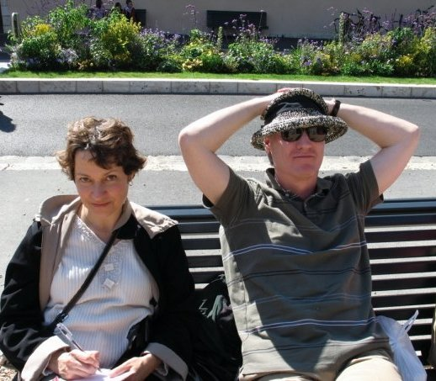
“Moral “chronicity” built on foundation of generalized “event representations”
Darcia & Dan
Event representations as “basic building blocks” of cognitive development
Are elaborated in dialogues with caregivers who help children review and consolidate memories in script-like fashion
Event representations as the building blocks of the moral personality…social cognitive foundation of character
…the social cognitive foundation of character

Slide 22
The key characterological turn of significance:
how early social cognitive units are transformed into autobiographical memory
Early social cognitive units
(Scripts, episodic memory, generalized event representations)
Autobiographical memory
(a social construction)
At some point specific episodic memories must be integrated into a narrative form that references a self whose story it is,

Slide 23
Parental interrogatives
“What happened when you pushed your sister?”
“What should you do next?”
Are a scaffold that helps children structure events in a narrative fashion
And provides, as part of the self-narrative, action-guiding scripts
“I say I’m sorry” “I share with him”
That become over-learned, routine, habitual, automatic.
Parents help children identify morally relevant features of their experience and encourage formation of social cognitive schemas that are chronically accessible.

Slide 24
What is the developmental source of moral desires?
A strong mutually responsive orientation (MRO) orients the child to be receptive to parental influence
G. Kochanksa
Committed compliance to norms & values of attachment figure
Motivates moral internalization
Secure Attachment
Committed Compliance
Moral Internalization

Slide 25
“Children with a strong history of committed compliance come to view themselves as embracing the parent’s values and rules. Such a moral self, in turn, comes to serve as the regulator of future moral conduct and, more generally, of early morality”
--Kochanska (2002,p. 340)
Wholehearted commitment
(Blasian moral identity)
Committed compliance
(MRO)

Slide 26
Longitudinal assessment: 25 mos., 38mos., 52 mos., 67 mos. & 80 mos.
Two, 2-3 hour laboratory session, one with each parent
At 38 months, one home and one lab (with each parent)
Child’s internalization of each parent’s rules and empathy towards parents’ distress observed in scripted paradigms at 25mo., 38mo. & 52 mos.
Moral self assessed with “puppet interview”
Adaptive, competent, prosocial and antisocial behavior rated by parents & teachers

Slide 27
Moral Self Puppet Assessment
Two puppets anchor opposite ends of 31 items
The items pertain to dimensions of early conscience (e.g., internalization of rules, empathy, apology, etc)
Puppet 1:
“When I break something, I try to hide it so no one finds out.”
Puppet 2:
“When I break something, I tell someone right away.”
Then the child is asked: “What about you? Do you try to hide something that you broke or do you tell someone right away?”

Slide 28
Children who as toddlers & preschoolers had strong history of internalized “out-of-sight” compliance with parents’ rules
Were competent, engaged, prosocial with few antisocial behavioral problems at early school age
Strong history of empathic responding at toddlers/preschool
Psychosocial competence at early school age
What mechanism accounts for this beneficial effect?
The Moral Self
Children’s moral self robustly predicted future competent behavior
Children at 67 mos. who were “highly moral” were rated at 80 mos. as highly competent, prosocial and having few antisocial problems

Slide 29
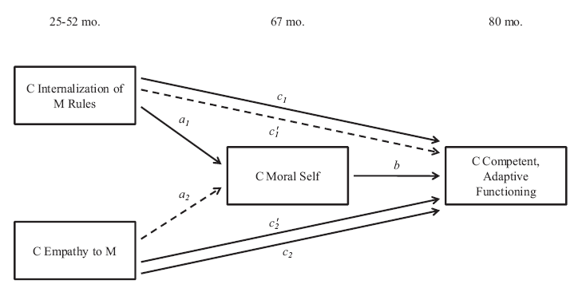

Slide 30
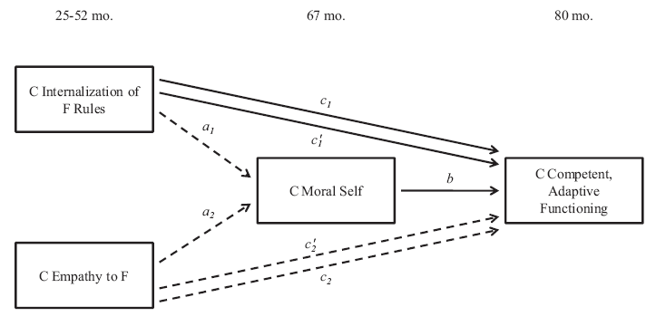

Slide 31
How does the moral self execute its inner guidance role?
Mechanisms not completely clear
Kochanka suggests
avoidance of cognitive dissonance
anticipation of guilty feelings,
automatic regulation due to high
accessibility of moral schemas

Slide 32
“In the end is my beginning”
--T.S. Eliot (“East Coker”)
Major Points
Moral identity reflects the importance of what we care about
A moral person engages in strong evaluation
But depends on accessibility of moral identity
(understood in social cognitive terms)
Moral identity can be chronically accessible or have high centrality within working self-concept
Or activated or deactivated by situations
There is a developmental story

